Slide 1

Vidya.AI Pitch Deck
March 6, 2023, | Chicago, Illinois
Ananth Prayaga
Garima Sohi
Kshitij Mittal
Manish Kumar
Urvaj Shah

Slide 2
Vidya
vid•ya (vid′yä)
Vidya is a Sanskrit noun meaning "right knowledge" and "clarity"
It is frequently used in South Asia, implying the conception of knowledge and learning.

Slide 3
Business Overview
Problem Statement
The objective is to evaluate the English language proficiency of 8th-12th grade students by analyzing their essay dataset.
To enhance the support for ELLs, a model will be developed using Data Mining techniques
This model can help reduce the grading burden for teachers and provide better feedback to students on their essays.
Who is an ELL?
ELLs refer to students who face difficulty communicating effectively and learning in English
ELLs belong to households and backgrounds where English is not the primary language.
Due to this, they need special or adjusted instruction to improve their language skills and academic performance.

Slide 4
Market Size
49.5M
Total
Students K-12
ELL students are among the fastest growing student population group
By 2025, 25% of public school students will be ELL students
16.1M
8-12th Grade
5M
English Language
Learners
Notes:
https://nces.ed.gov/fastfacts/display.asp?id=372
https://start.askwonder.com/insights/want-size-english-second-language-esl-k-12-market-united-states-may-referred-z459nom0f

Slide 5
Data Pre-processing

Slide 6
Data Pre-processing
1
2
3
4
Text Cleaning
Lemmatize & POS
Spelling Mistakes
Count Aggregation
a. Apply contractions (don't → do not)
b. Cleaning:
- Lower text, Strip extra spaces, Tabs
- Remove Stop words and Punctuation (and, the, for)
c. Word Tokenization
a. Part of Speech Identification:
- Adverb
- Noun
- Verb
- Adjective
b. Lemmatization (Studying → Study)
a. Identifying Mistakes
b. Correcting Mistakes
a. Word Count
b. Count Spelling Mistakes
c. Count Sentence Metrics - Length
- Count
d. POS counts – Noun, Adjective, Adverb & Verb

Slide 7
Exploratory Data Analysis

Slide 8
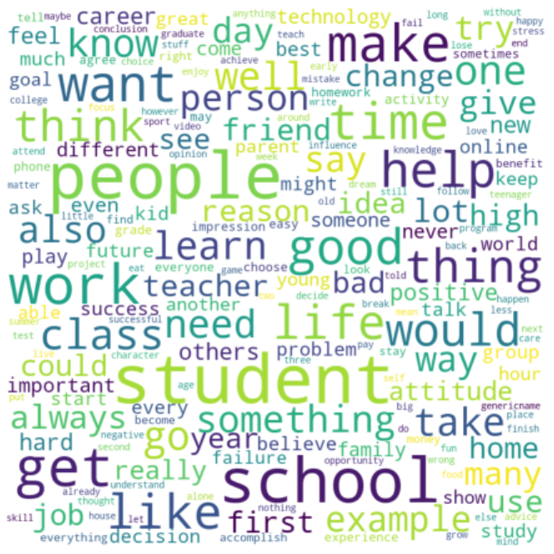
Word Cloud

Slide 9
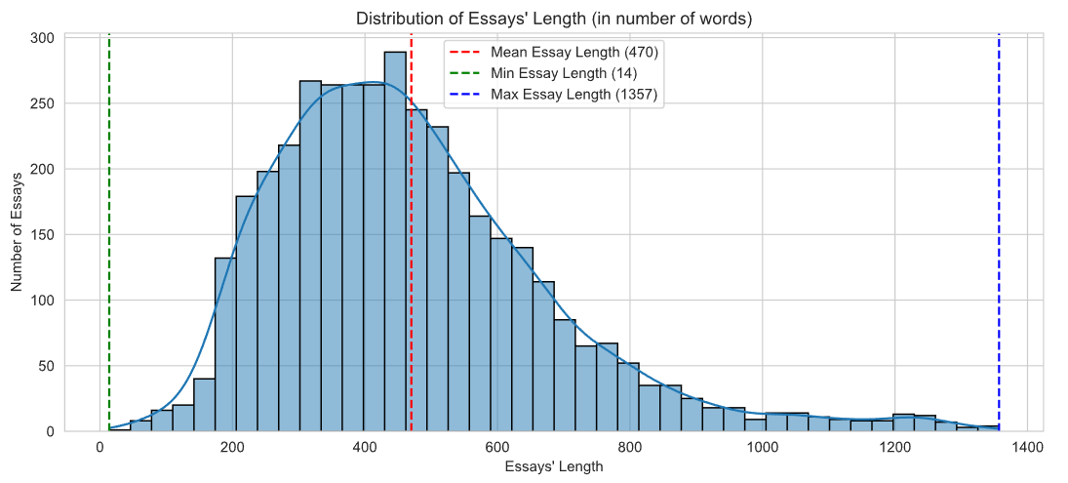
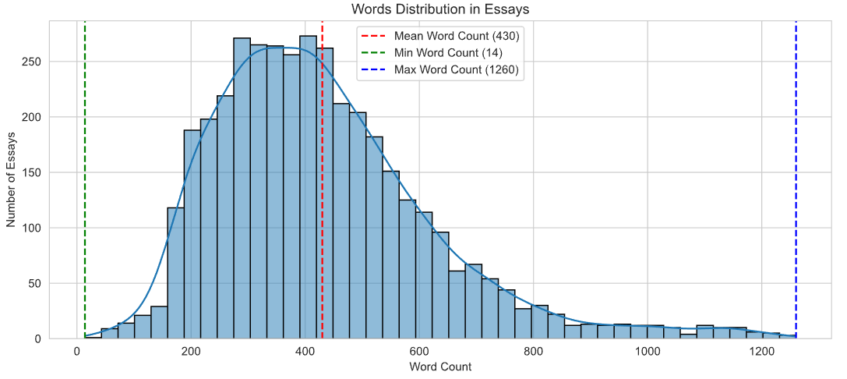

Analyzing Essay Lengths
Essay Lengths
‘Cleaned’ Essay Lengths
Some students have written very lengthy essays which skews the overall distribution towards right
This visualization is in alignment with the essay length signifying how some students used more words to write essays and made the normal distribution rightly skewed.

Slide 10
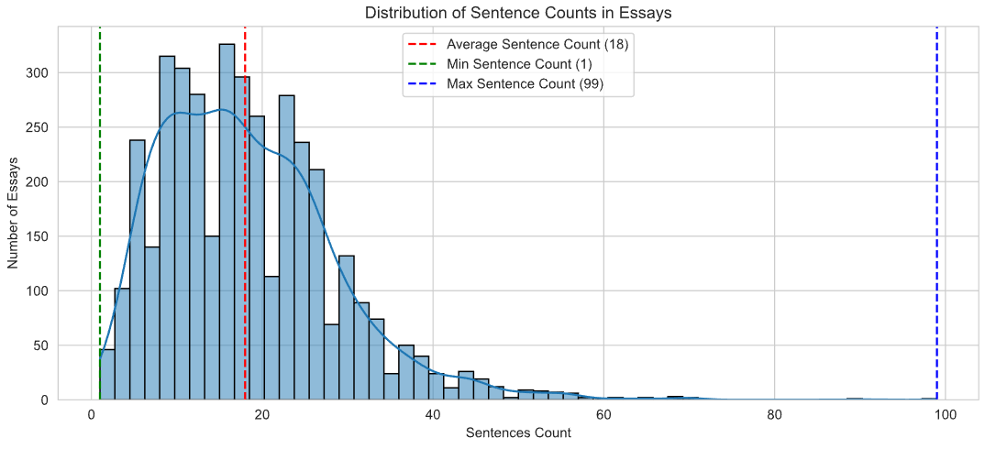
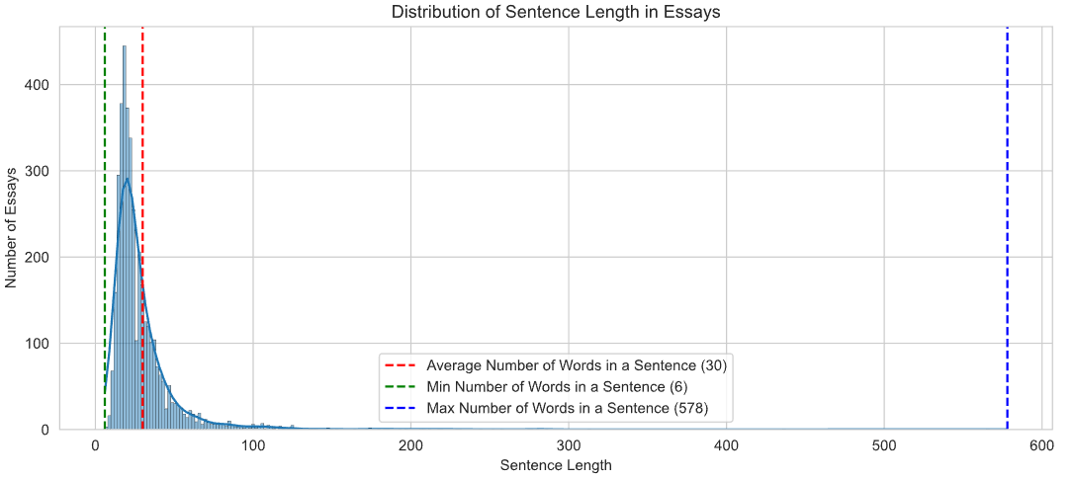
Sentence Analysis
Distribution of Sentence Count
Distribution of Sentence Length
Each student exhibits a distinct writing style, with number of sentences varying in each essay
The distribution of sentences count is highly right-skewed in nature, which signifies how some students wrote exceptionally long sentences.

Slide 11
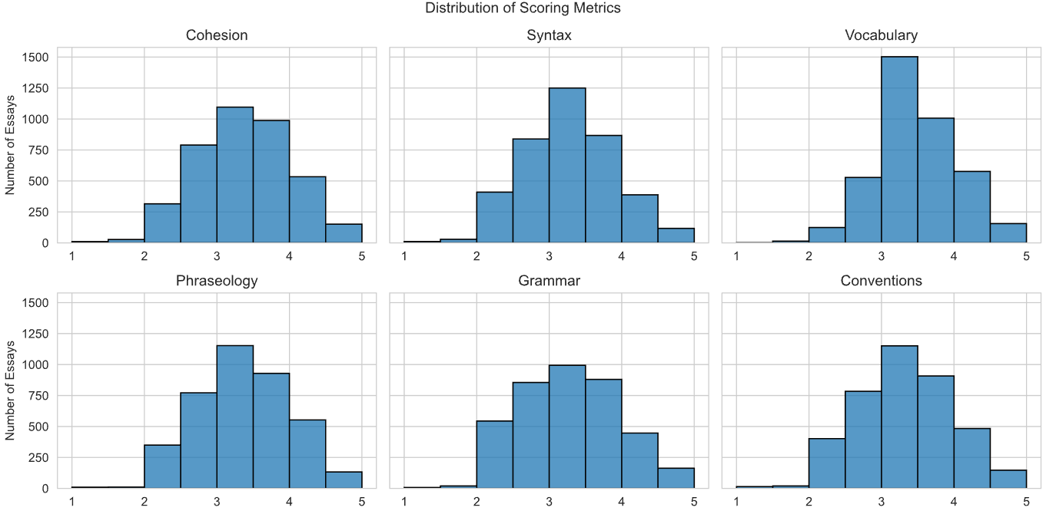
Essays were graded on 6 metrics

Slide 12
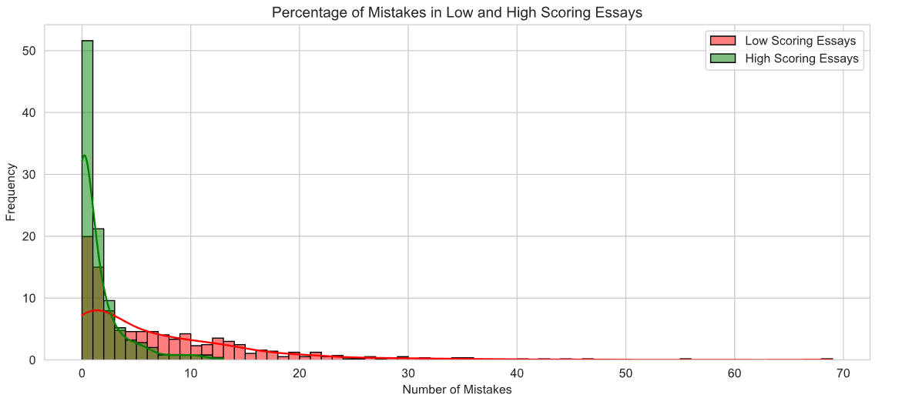
Essays were divided into three scoring groups
ESSAYS
If an essays has the following scores in more than 4 metrics
<= 2.5
>= 4.0
else
Essays with more spelling mistakes were scored poorly
Low-Scored
Essays
High-Scored
Essays
Medium-Scored
Essays

Slide 13
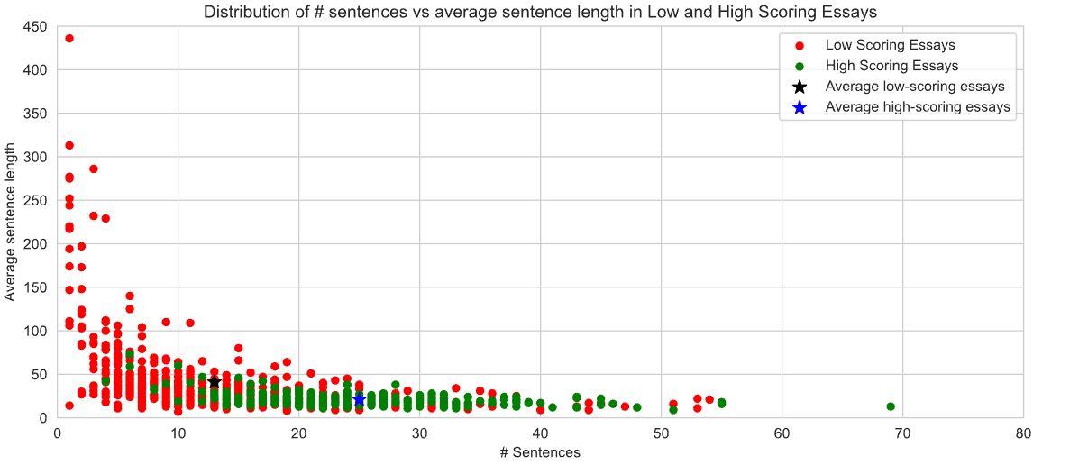
Different scoring groups
Students with high scoring essays used shorter sentences, whereas students who got low score wrote fewer but lengthy sentences.
Sentence count vs length

Slide 14
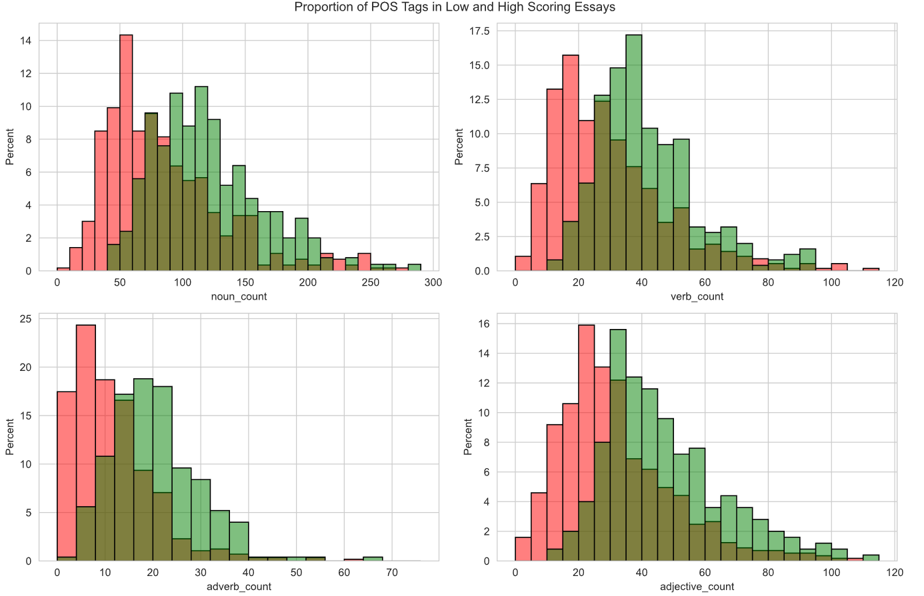
Part-of-Speech Tagging
POS Tags in High vs Low scored essays
Students who got a high score in their essays, more likely to use more nouns, adverbs, adjectives and verbs.

Slide 15
Topic Modeling

Slide 16
Topic Modeling
Processed Tokens
Having close to 4000 essays in our corpus, we wanted to analyze:
If there were specific topics emerging from these essays
Whether certain essay topics had an associated scoring bias
Word Embeddings
KMeans
LDA
BERTopic

Slide 17
Word Embeddings
To convert our list of lemmatized text into numerical representation, we
implemented 5 embedding techniques.
BOW
TF-IDF
Word2Vec
Creates an unordered set (Bag) of words – only accounts for word presence or absence
Evaluates the importance of a word in a document by multiplying the frequency (TF) with the logarithm of the inverse frequency of that word in the corpus (IDF)
Trains a neural network to predict the probability of a word based on its context or the probability of a context given a word.
Count Vectorizer
BERT
Pre-trained large language model (developed by Google) trained on a diverse range of text data, including Wikipedia articles, books, and web pages
Uses BOW to create a matrix using the frequency of each word in the document

Slide 18
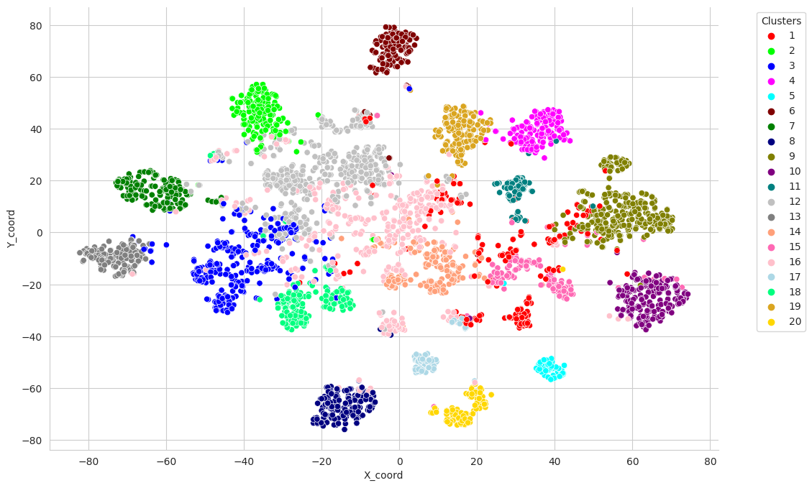
Word2Vec with KMeans
KMeans visualization with TSNE
Created Word2Vec embeddings for each tokenized word (corrected) in our corpus
Translated word-level embeddings to document-level embeddings by averaging the word2vec embeddings for each word
Implemented KMeans clustering for n=20 clusters

Slide 19




Few emerging Topics (with most representative keywords)
Cluster 11 Vacation and Summer Breaks
Cluster 05 Food and Meals
summer vacation break winter longer evening period long spring shorter
cafeteria eat healthier food lunch menu meal starve healthy vegetable
Cluster 08 Impact of Technology
Cluster 14 Hobbies and Vocational activities
technology contact device social medium today limitation addict human tool
swim sing bike dance lionel football basketball ride ball guitar

Slide 20
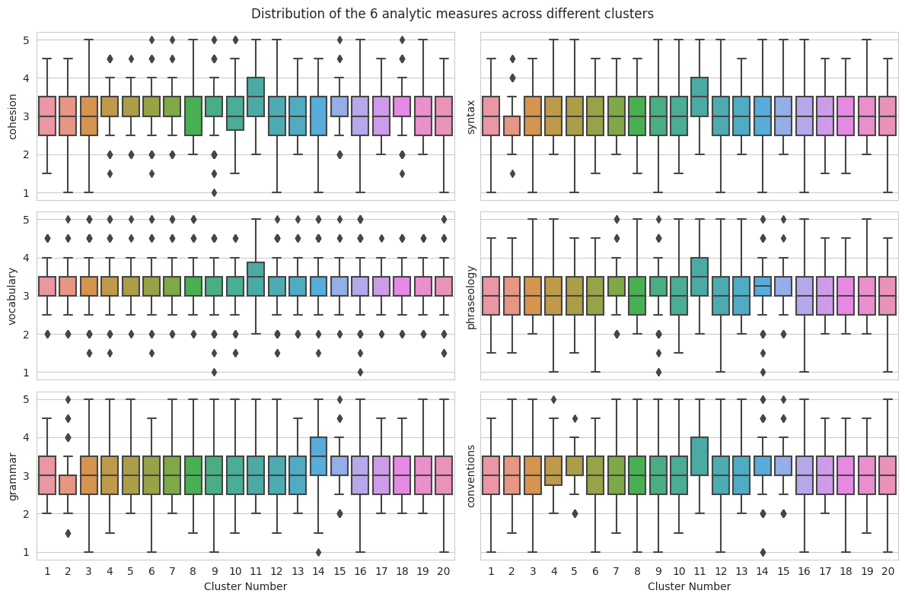
We do not observe any scoring bias in any of the topic clusters Cluster 11 (vacation) does show slightly higher scores

Slide 21
Topic Modeling - LDA
We tried to identify 20 different topics using LDA. LDA algorithm finds the weight of connections between documents and topics and between topics and words.
It started off by randomly assigning topics to each word in our essays. It then calculates a document to topic count.
The model converges by re-assigning the topic of each word, so that each word is assigned to min number of topics
Each topic is a list of probabilities of words
Each document is a list of probabilities of topics
3911 documents
20 Topics
Words

Slide 22




Few LDA Topics (with most representative keywords)
Topic 14 Goal Setting
Topic 12 Self-Esteem
goal, could, achieve, high, set, may, would, great, aim, low
work, student, praise, achievement, believe, skill, improve, self-esteem, confidence
Topic 06 Importance of trying new things
Topic 17 Imagination and Creativity
try, thing, get, make, something, never, know, learn, new, life
knowledge, imagination, art, use, imagine, important, think, draw, create, make

Slide 23
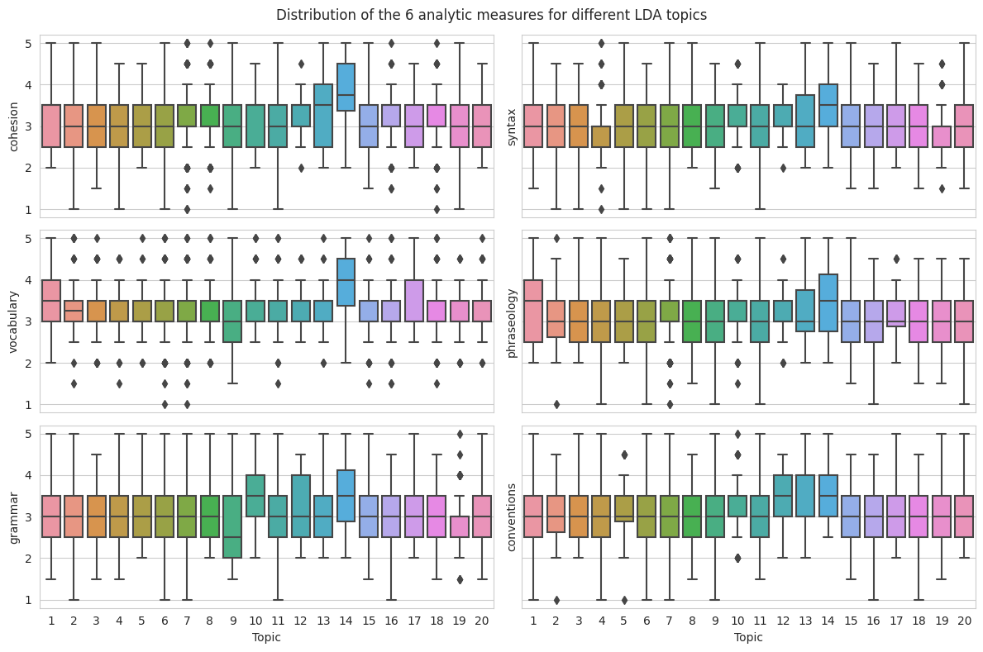
Topic 14 (Goal setting) did show consistently higher scores in all analytic measures

Slide 24
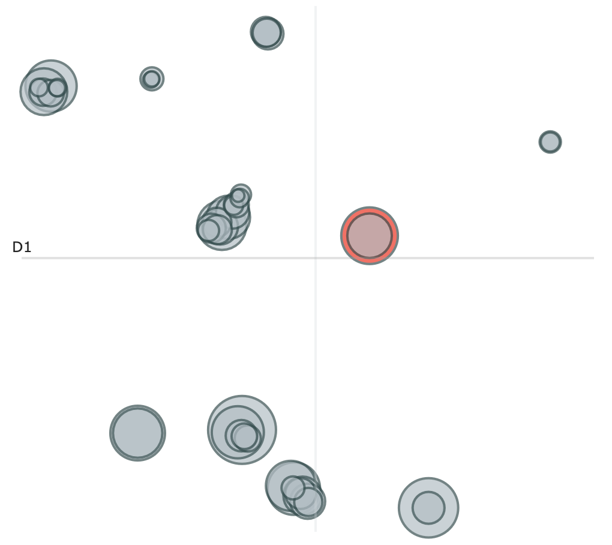
BERT (Experiment)
BERT identified 47 topics (Intertopic distances below)
BERT takes into account the entire context of a word in a sentence (document), rather than just the words that come before or after it
BERT Topic applies a clustering algorithm like HDBSCAN to BERT embedded (and dimensionality reduced) data to group similar documents into topics
It can automatically determine the optimal number of topics without manual tweaking

Slide 25




Interesting BERT Topics (with most representative keywords)
Topic 0 Online learning
Topic 15 Homework and Assignments
online, class, home, attend, student, school, benefit, take, learn, video
homework, club, teacher, help, student, school, afterschool, get, grade, understand
Topic 29 Community Service
Topic 40 Job Market
community, service, clean, help, principal, dear, perform, trash, litter
job, hire, employee, employer, work, experience, hard, responsible, company, customer

Slide 26
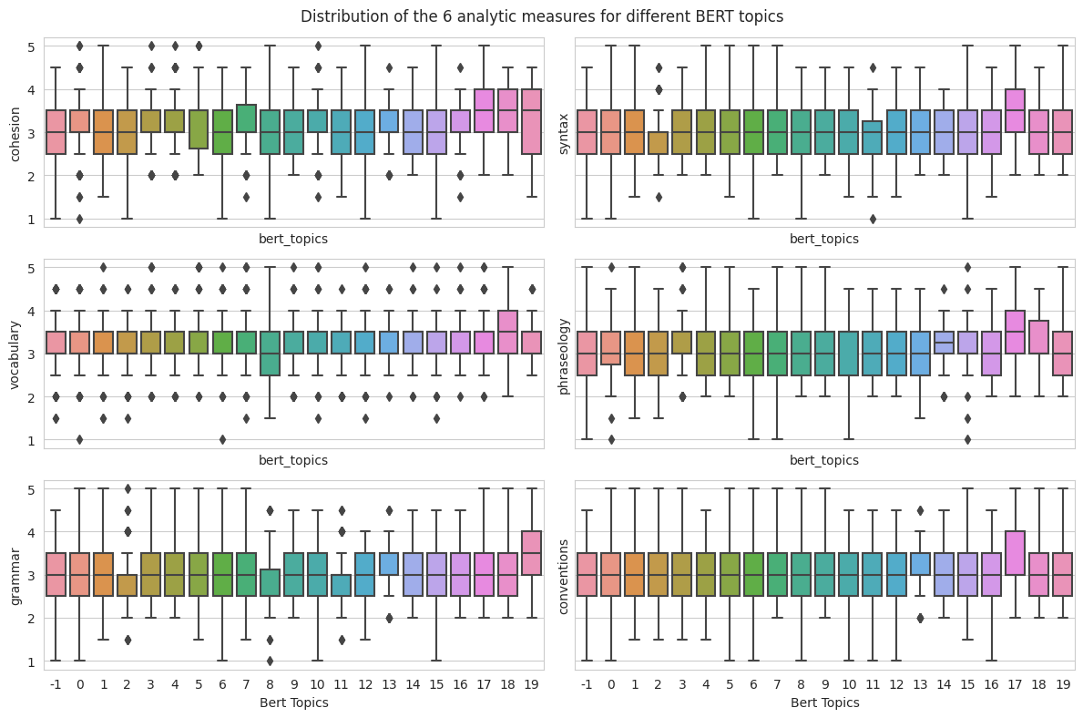
Scores for top 20 Bert topics No topic was showing a particular scoring bias

Slide 27
Modeling

Slide 28
Data Mining Pipeline
Raw Data
Preprocessing
Feature Extraction
Modeling
Modeling
- ~4000 Essays
- Six Scoring Areas
- Cleaning
- Tokenization
- Lemmatization
- Parts of Speech
- Word Correction
- Data Mining
- Bag of Words
- CV
- TF-IDF (1gram)
- TF-IDF (2gram)
- Word2Vec
- Glove
- BERT
- Linear Regression
- Random Forest
- SVM
- XGBoost

Slide 29
Modeling Approach
5-Fold CV
Clean Corrected Lemmatized Tokens
Count Vector
Linear Regression
Cohesion
Conventions
TF-IDF 1/2 Gram
Random Forest Regression
Grammar
Word2Vec
XGBoost Regression
Phraseology
Syntax
GLOVE
SVM Regression
Vocabulary

Slide 30
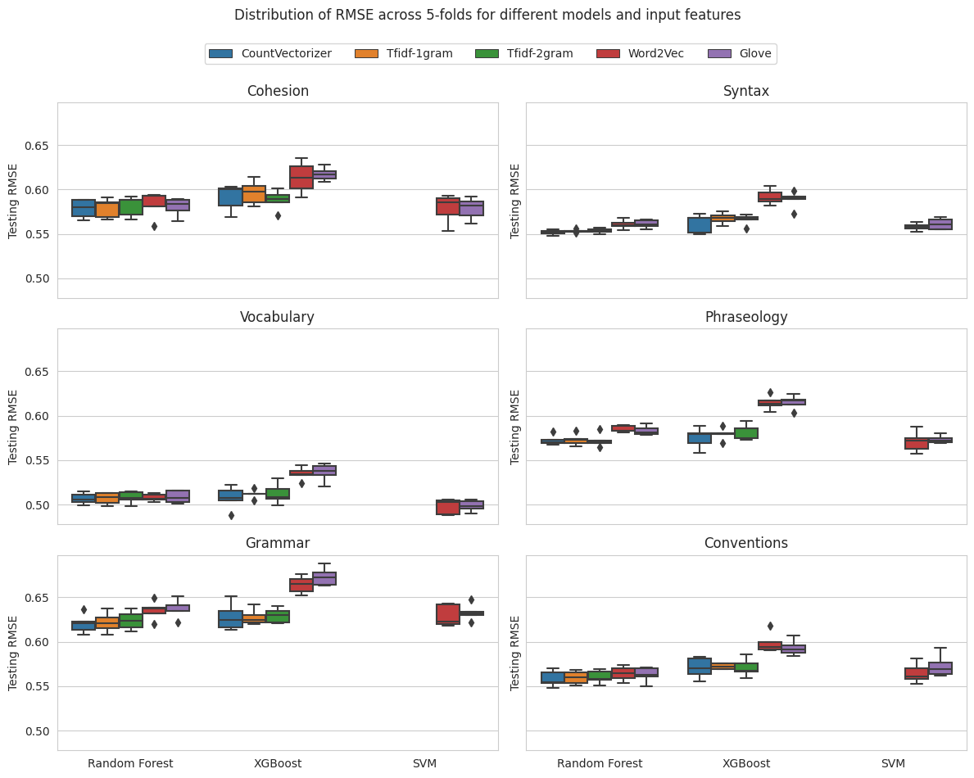
Modeling Results Some measures are more difficult to model than the others

Slide 31
Modeling Results
 | Target | Embedding | Model | RMSE | MAE
 | Cohesion | CountVectorizer | Random Forest | 0.58 | 0.47
 | Conventions | CountVectorizer | Random Forest | 0.56 | 0.44
 | Grammar | CountVectorizer | Random Forest | 0.62 | 0.50
 | Phraseology | Word2Vec | SVM | 0.57 | 0.45
 | Syntax | CountVectorizer | Random Forest | 0.55 | 0.44
 | Vocabulary | Glove | SVM | 0.49 | 0.39

Slide 32
Results and Recommendations

Slide 33
Results
We built an interactive app
This tool can be used by graders and students both to analyze their essay submissions
The tool is powered by the Random Forest Model we obtained from our training data
Given this tool is built for ELLs, it provides many learning features that can help them improve their writing

Slide 34
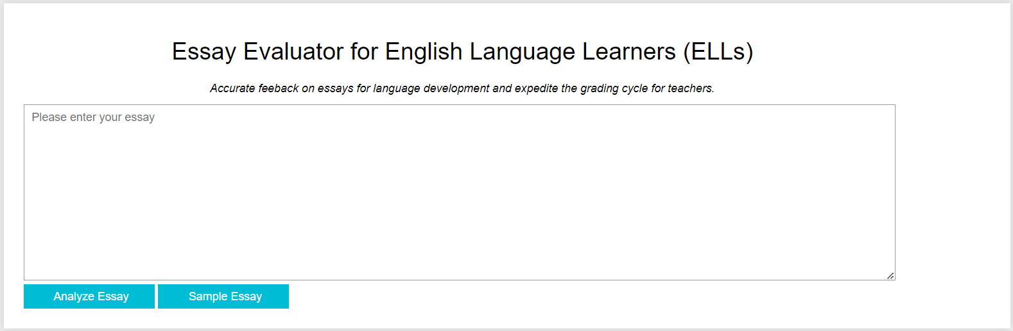
App UI

Slide 35
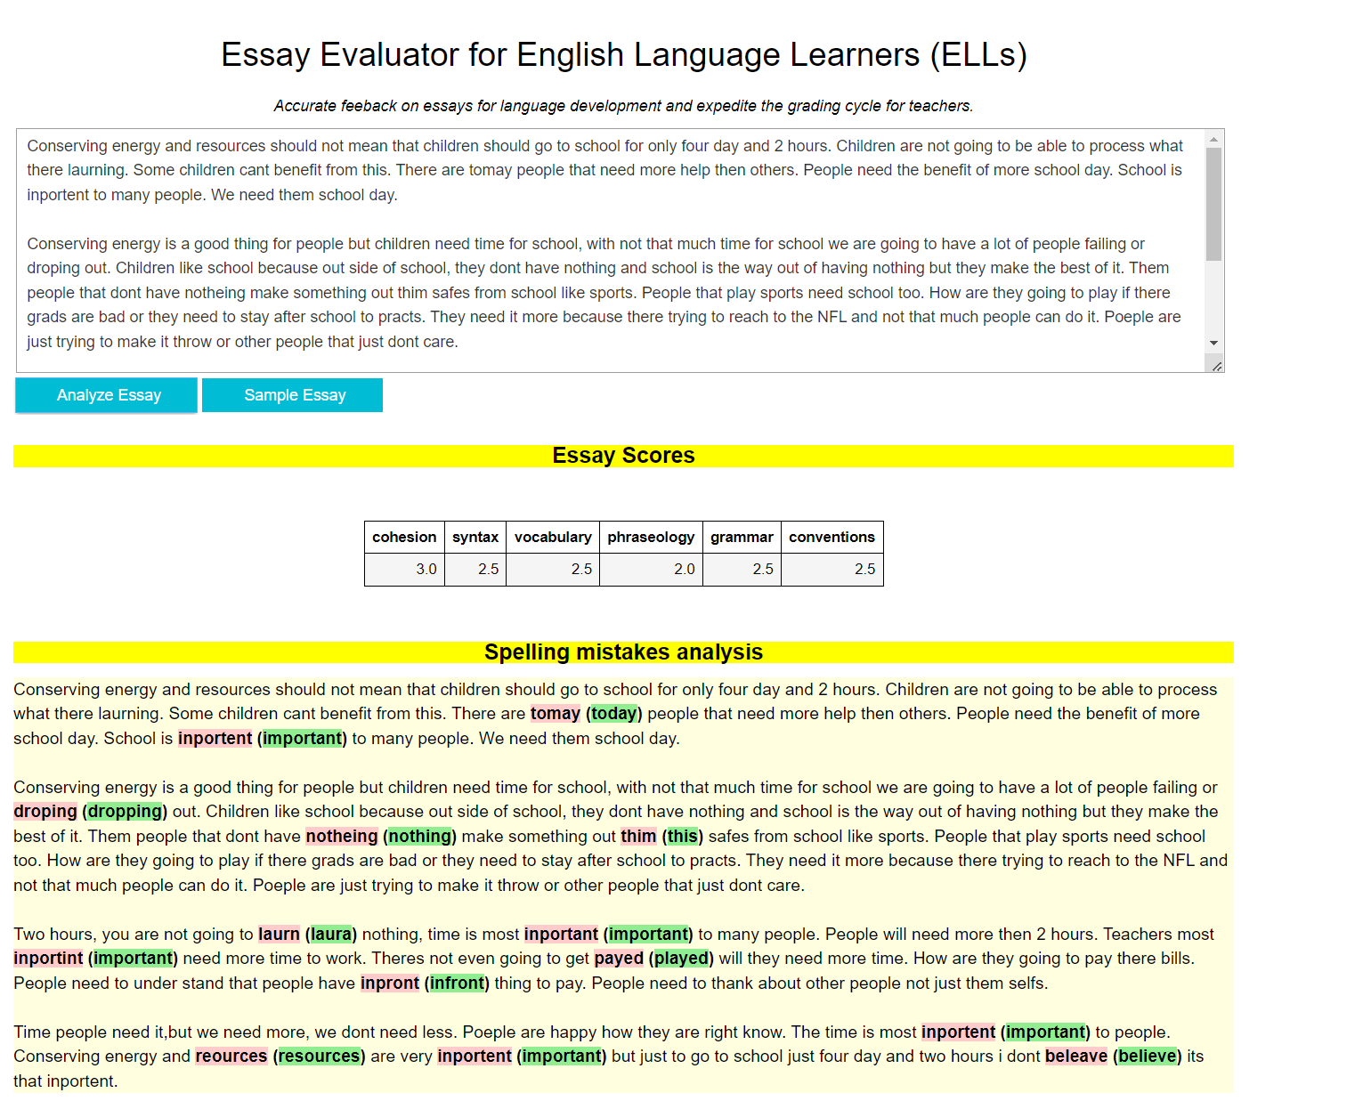
App UI (contd.)

Slide 36
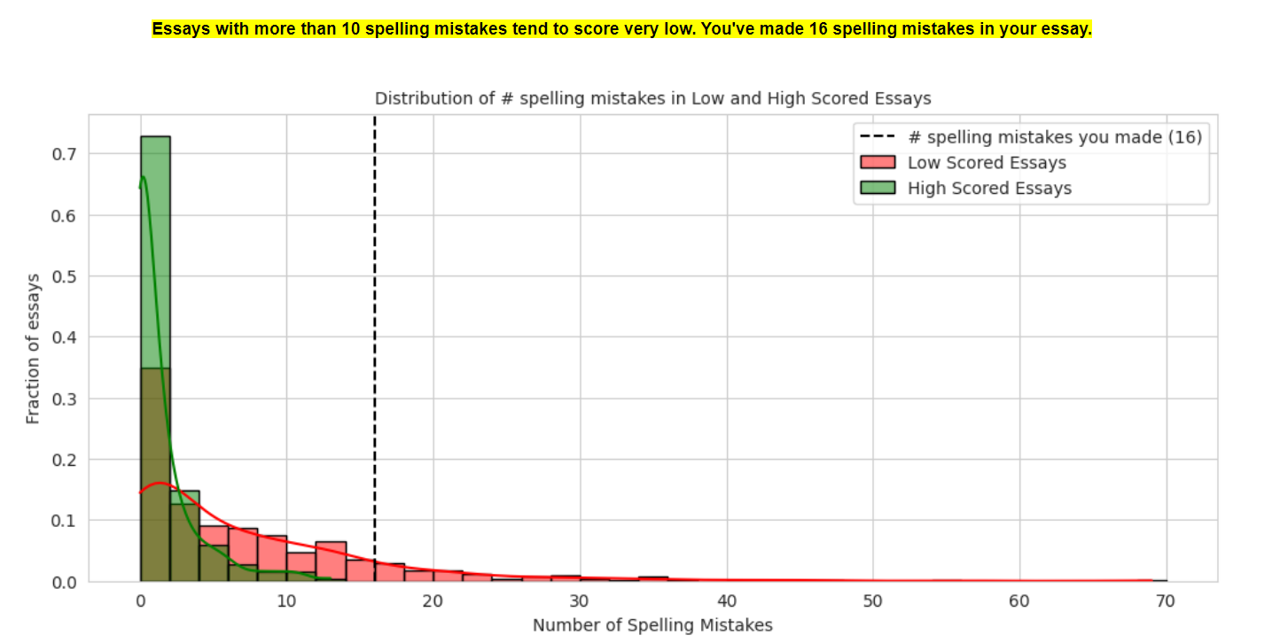
Recommendations

Slide 37
Thank you

